Slide 1
Operating Systems Overview
Covers Chapter#02 from Textbook

Slide 2
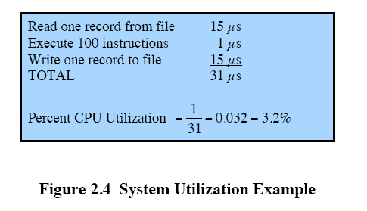
Multiprogrammed Batch Systems
Even with the automatic job sequencing provided by a simple batch OS, the processor is often idle due to I/O devices being slow compared to the processor.
Multiprogramming was designed to keep processor and I/O devices, busy simultaneously to achieve maximum efficiency.
Multiprogramming or multitasking, is the central theme of modern operating systems.

Slide 3
Multiprogrammed Batch Systems (Cont.)

Slide 4
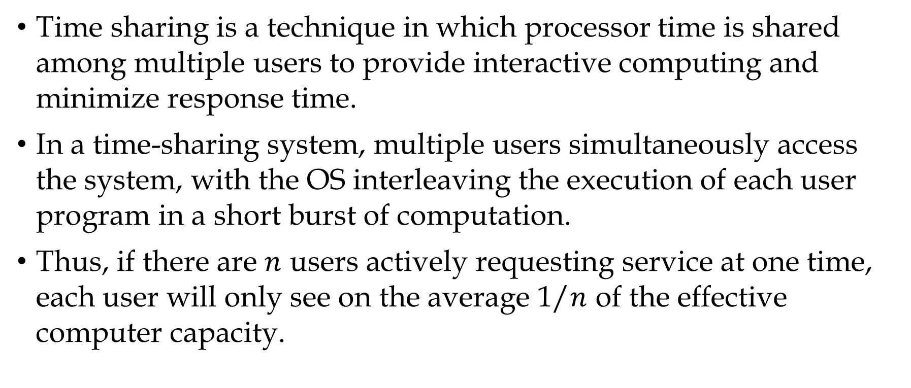
Time-Sharing Systems
Time sharing is a technique in which processor time is shared among multiple users to provide interactive computing and minimize response time.
In a time-sharing system, multiple users simultaneously access the system, with the OS interleaving the execution of each user program in a short burst of computation.
Thus, if there are $n$ users actively requesting service at one time, each user will only see on the average 1/$n$ of the effective computer capacity.

Slide 5
Major Achievements
There have been four major theoretical advances in development of operating systems:
Processes
Memory management
Information protection and security
Scheduling and resource management

Slide 6
The Process
Process: is a program in execution OR an instance of a program running on a computer.
There are four main causes of system programming errors:
Improper synchronization: e.g. improper design of signaling.
Failed mutual exclusion: e.g. access same file simultaneously
Nondeterminate program operation: multiple programs in shared memory
Deadlocks: e.g. two I/O devices waiting for each other.
The concept of process provides the foundation to tackle the above problems as a systematic way to monitor and control the various programs executing on the processor.

Slide 7
The Process (Cont.)
The process contains three components:
An executable program.
The associated data needed by the program (variables, buffers, etc).
The execution context (i.e. process state) of the program.
Execution context: the internal data by which the OS is able to supervise and control the process.
The execution context include contents of various processor registers (e.g. program counter and data registers), priority of the process and whether the process is waiting for completion of an I/O event.

Slide 8
The Process (Cont.)
Each process in memory is recorded in a process list.
The process list contains one entry for each process (pointer).
The entire state of the process at any instant is contained in its context.
New features can be incorporated in OS by expanding the context to include any new information needed to support that feature.

Slide 9
Memory Management
The OS has five principal storage management responsibilities:
Process isolation: The OS must prevent independent processes from interfering with each other’s memory, both data and instructions.
Automatic allocation and management: Programs should be dynamically allocated across the memory hierarchy as required.
Support of modular programming: Programmers should be able to define program modules, create, destroy and alter the size dynamically.
Protection and access control: OS must allow portions of memory to be accessible in various ways (protected and shared).
Long-term storage: Many application programs require means for storing information for extended periods of time.

Slide 10
Memory Management (Cont.)
Techniques used by OS for achieving memory management requirements:
File system implements a long-term storage with information stored in named objects, called files.
Virtual memory allows programs to address memory from a logical point of view. It gives an ability to run programs larger than the physical memory by rapidly moving pieces back and forth between RAM and disk.
Paging allows processes to be comprised of a number of fixed-size blocks, called pages.

Slide 11
Information Protection and Security
Work performed in OS related security and protection can be grouped into four categories:
Confidentiality: assures that users cannot read data for which access is unauthorized.
Integrity: protection of data from unauthorized modification.
Availability: protecting the system against interruption.
Authenticity: proper verification of the identity of users and the validity of messages or data.

Slide 12
Scheduling and Resource Management
Any resource allocation and scheduling policy must consider three factors:
Fairness: to facilitate all processes that are competing for the use of a particular resource to be given approximately equal and fair access to that resource.
Differential responsiveness: to discriminate among different classes of jobs with different service requirements. The OS should attempt to make dynamic allocation and scheduling to meet the total set of requirements.
Efficiency: to maximize throughput, minimize response time and accommodate as many users possible (time sharing).

Slide 13
Different Architectural Approaches
Monolithic kernel: the entire operating system runs as a single program in kernel mode. OS functionality is provided in these large kernels, including scheduling, file system, networking, device drivers, memory management, and more. E.g. Linux.
Microkernel: putting as little as possible in kernel mode because bugs in the kernel can bring down the system instantly. E.g. Minix.
Only few essential functions are assigned to the kernel, including address spaces, interprocess communication (IPC), and basic scheduling.
Other OS services are provided by processes that run in user mode and are treated like any other application (well suited to a distributed environment).

Slide 14
Different Architectural Approaches (Cont.)
Symmetric multiprocessing (SMP): The OS of an SMP schedules processes or threads across all of the processors.
SMP has a number of potential advantages over uniprocessor architecture:
Performance
Availability
Incremental growth
Multithreading and SMP are often discussed together, but the two are independent facilities. However, the two facilities complement each other and can be used effectively together.

Slide 15
Different Architectural Approaches (Cont.)
Multithreading: is a technique in which a process is divided into threads that can run concurrently.
Distributed operating system: provides the illusion of single main/secondary memory space, plus other unified access facilities, such as a distributed file system.
Object-oriented design: lends discipline to the process by adding modular extensions to a small kernel.

Slide 16
Thank You!

